Slide 1
FULL STACK DEVELOPER BEYOND YOUR IMAGINATION
Your road map starts from here..

Slide 2
TEAM MEMBERS
1
2
3
Mamon Mohamed
Karim Mostafa Amin
Mazen El Basyone
4
5
6
Mohamed Ahmed Amin
Mhamed Ibrahim Mosbah
Loai Wael Hassan
Leader
Team member
Team member
Team member
Team member
Author

Slide 3
Introduction
The definition of full stack developer.
How this developer works.
The meaning of frontend and backend.
The required programming languages for this roadmap.
Opportunities in the labor market.

Slide 4
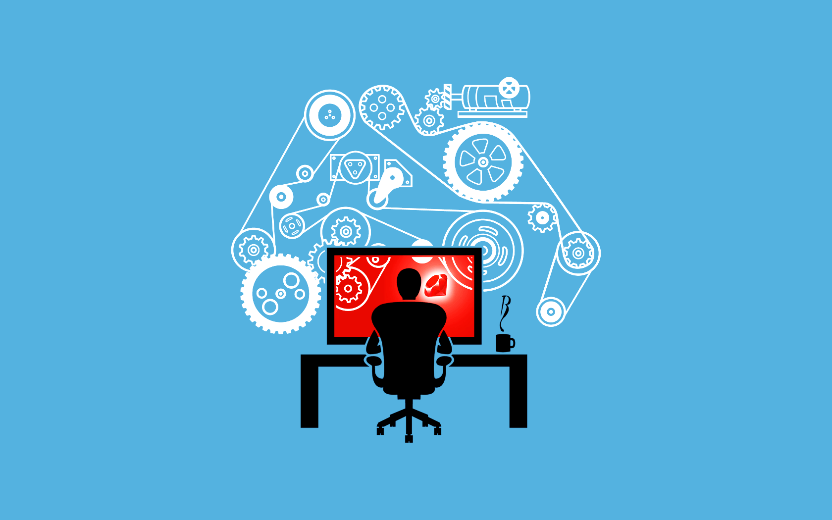
FULL STACK DEVELOPER
It’s a term used to describe a developer who is skilled in both front-end and back-end development.
A combination of the front end and the back end is required from the company when you need only one person, and you do not need to combine the code or establish rules for understanding the code from the frontend and the backend like HTML, Python and JavaScript

Slide 5


FULL STACK DEVELOPER
FRONT-END
BACK-END
Languages
HTML + CSS + JavaScript
Languages
Python || PHP || java ...etc

Slide 6
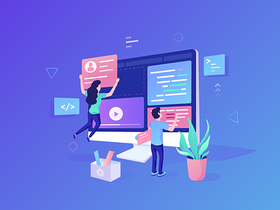
1. FRONTEND DEVELOPER
Is someone who specializes in creating the presentation layer ( user interface ) such as the menu, text, images and videos in the web page.
They are focusing on how the website looks and how users can interact with it.

Slide 7
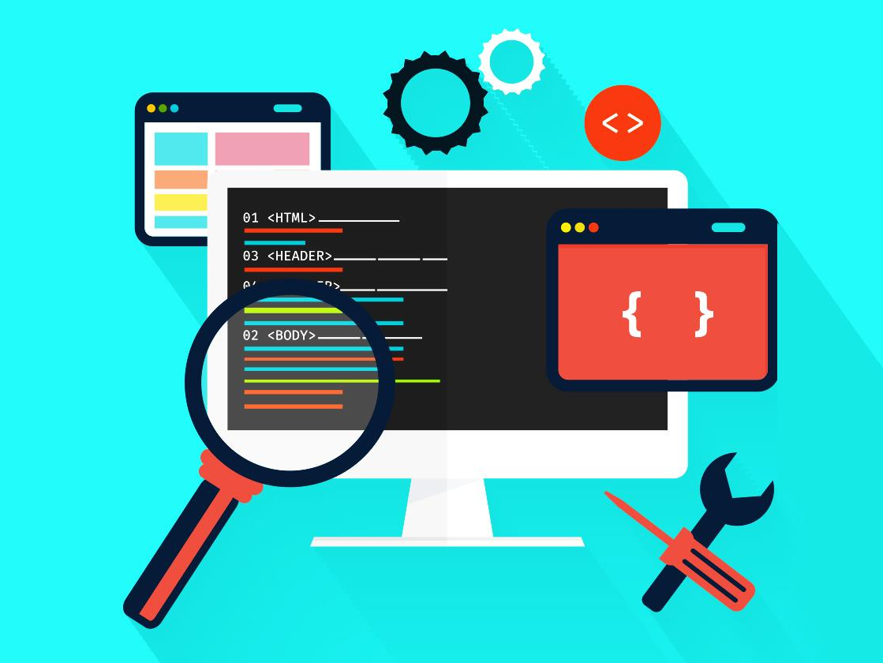
HOW TO BECOME A FRONTEND DEVELOPER ?
To become a frontend developer, you will have to learn HTML, CSS and JavaScript.
These are the building blocks of web development.

Slide 8
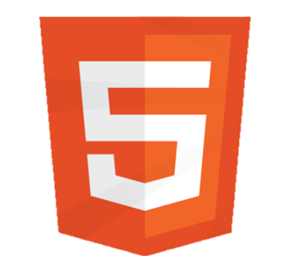
1
HTML
It’s like the skeleton of the webpage that holds all the content together and the most important language for the frontend career.

Slide 9
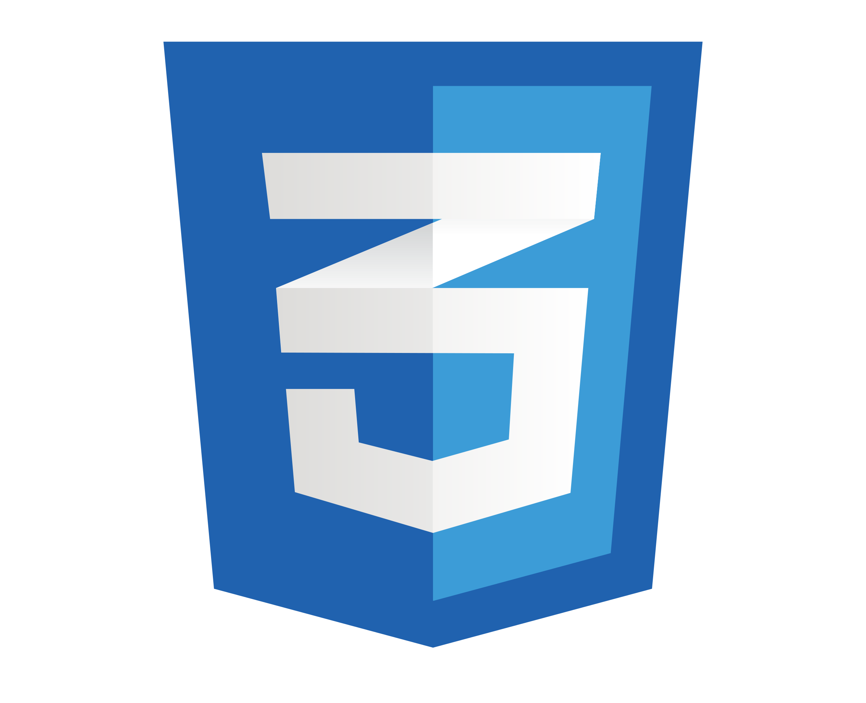
2
CSS
It works hand in hand with HTML to control the visual appearance of the webpage.

Slide 10
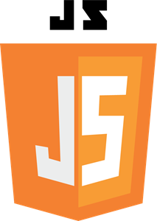
3
JavaScript
It’s used for frontend and backend web development.
Its allows you to add interactivity and dynamic behavior to your web pages.
It’s an essential skill for any web developer.

Slide 11
After learning all of these languages you can be called a frontend developer.

Slide 12
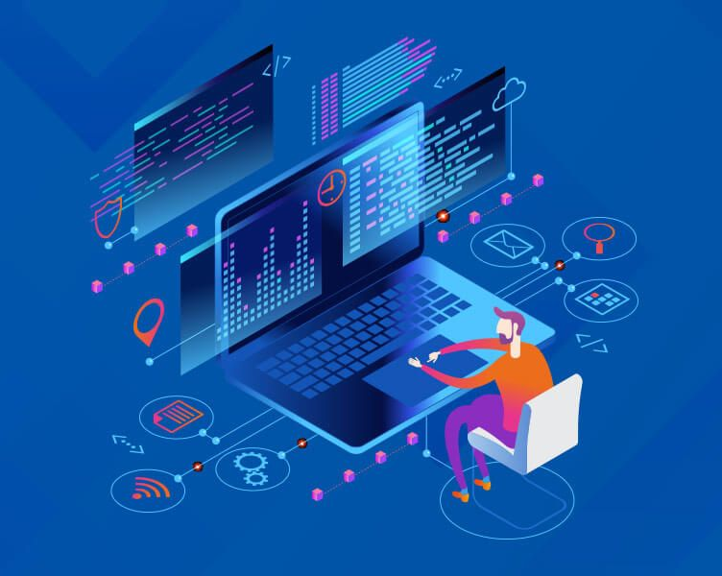
2. BACKEND DEVELOPER
Is someone who focuses on the server-side of a website.
They are handling the logic, data storage and communication with the frontend.

Slide 13
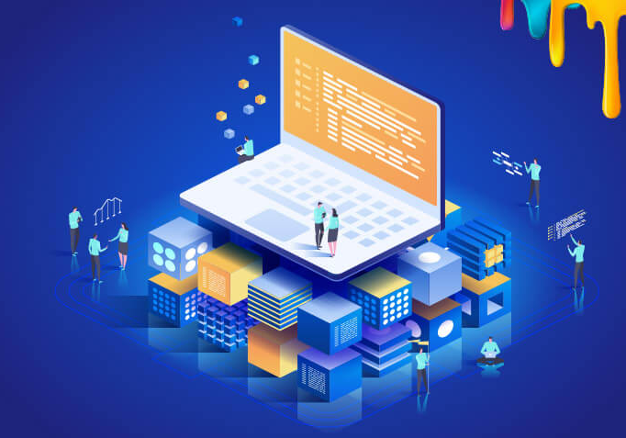
HOW TO BECOME A BACKEND DEVELOPER ?
To become a backend developer, you need to learn programing languages like Python, java or c#...etc.
It’s also important to understand databases and server-side frameworks.

Slide 14
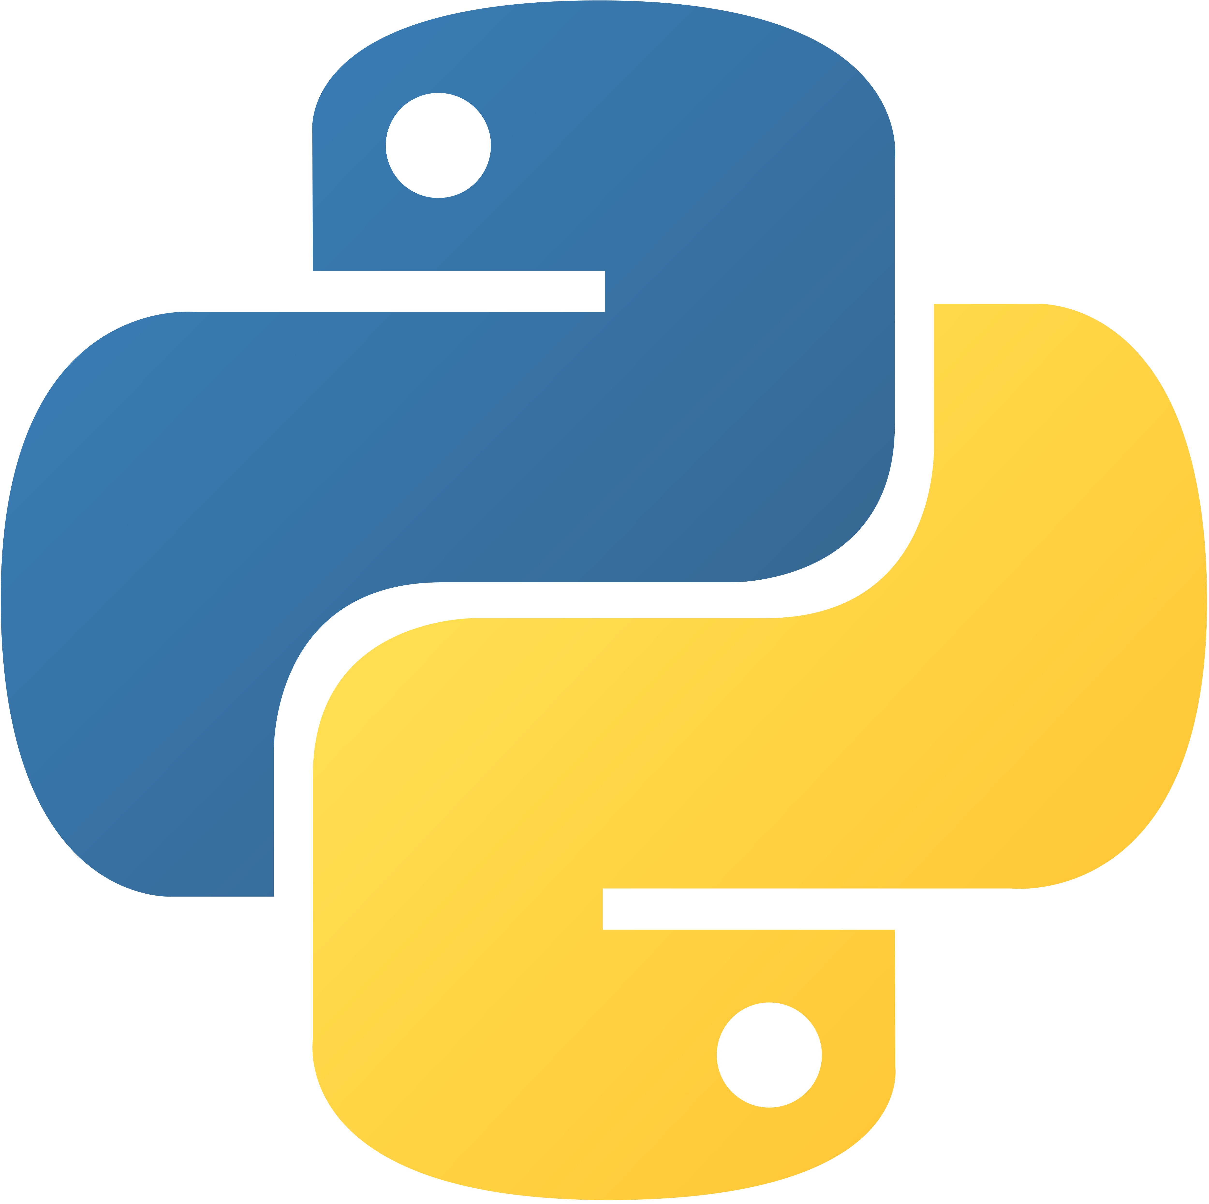
1
Python
It provides a wide range of libraries and frameworks such as flask and DJANGO that make is easier to handle server-side logic, interact with databases like MYSQL and process data.
Python is the most simple programing language that’s why you can choose it for the backend development.

Slide 15
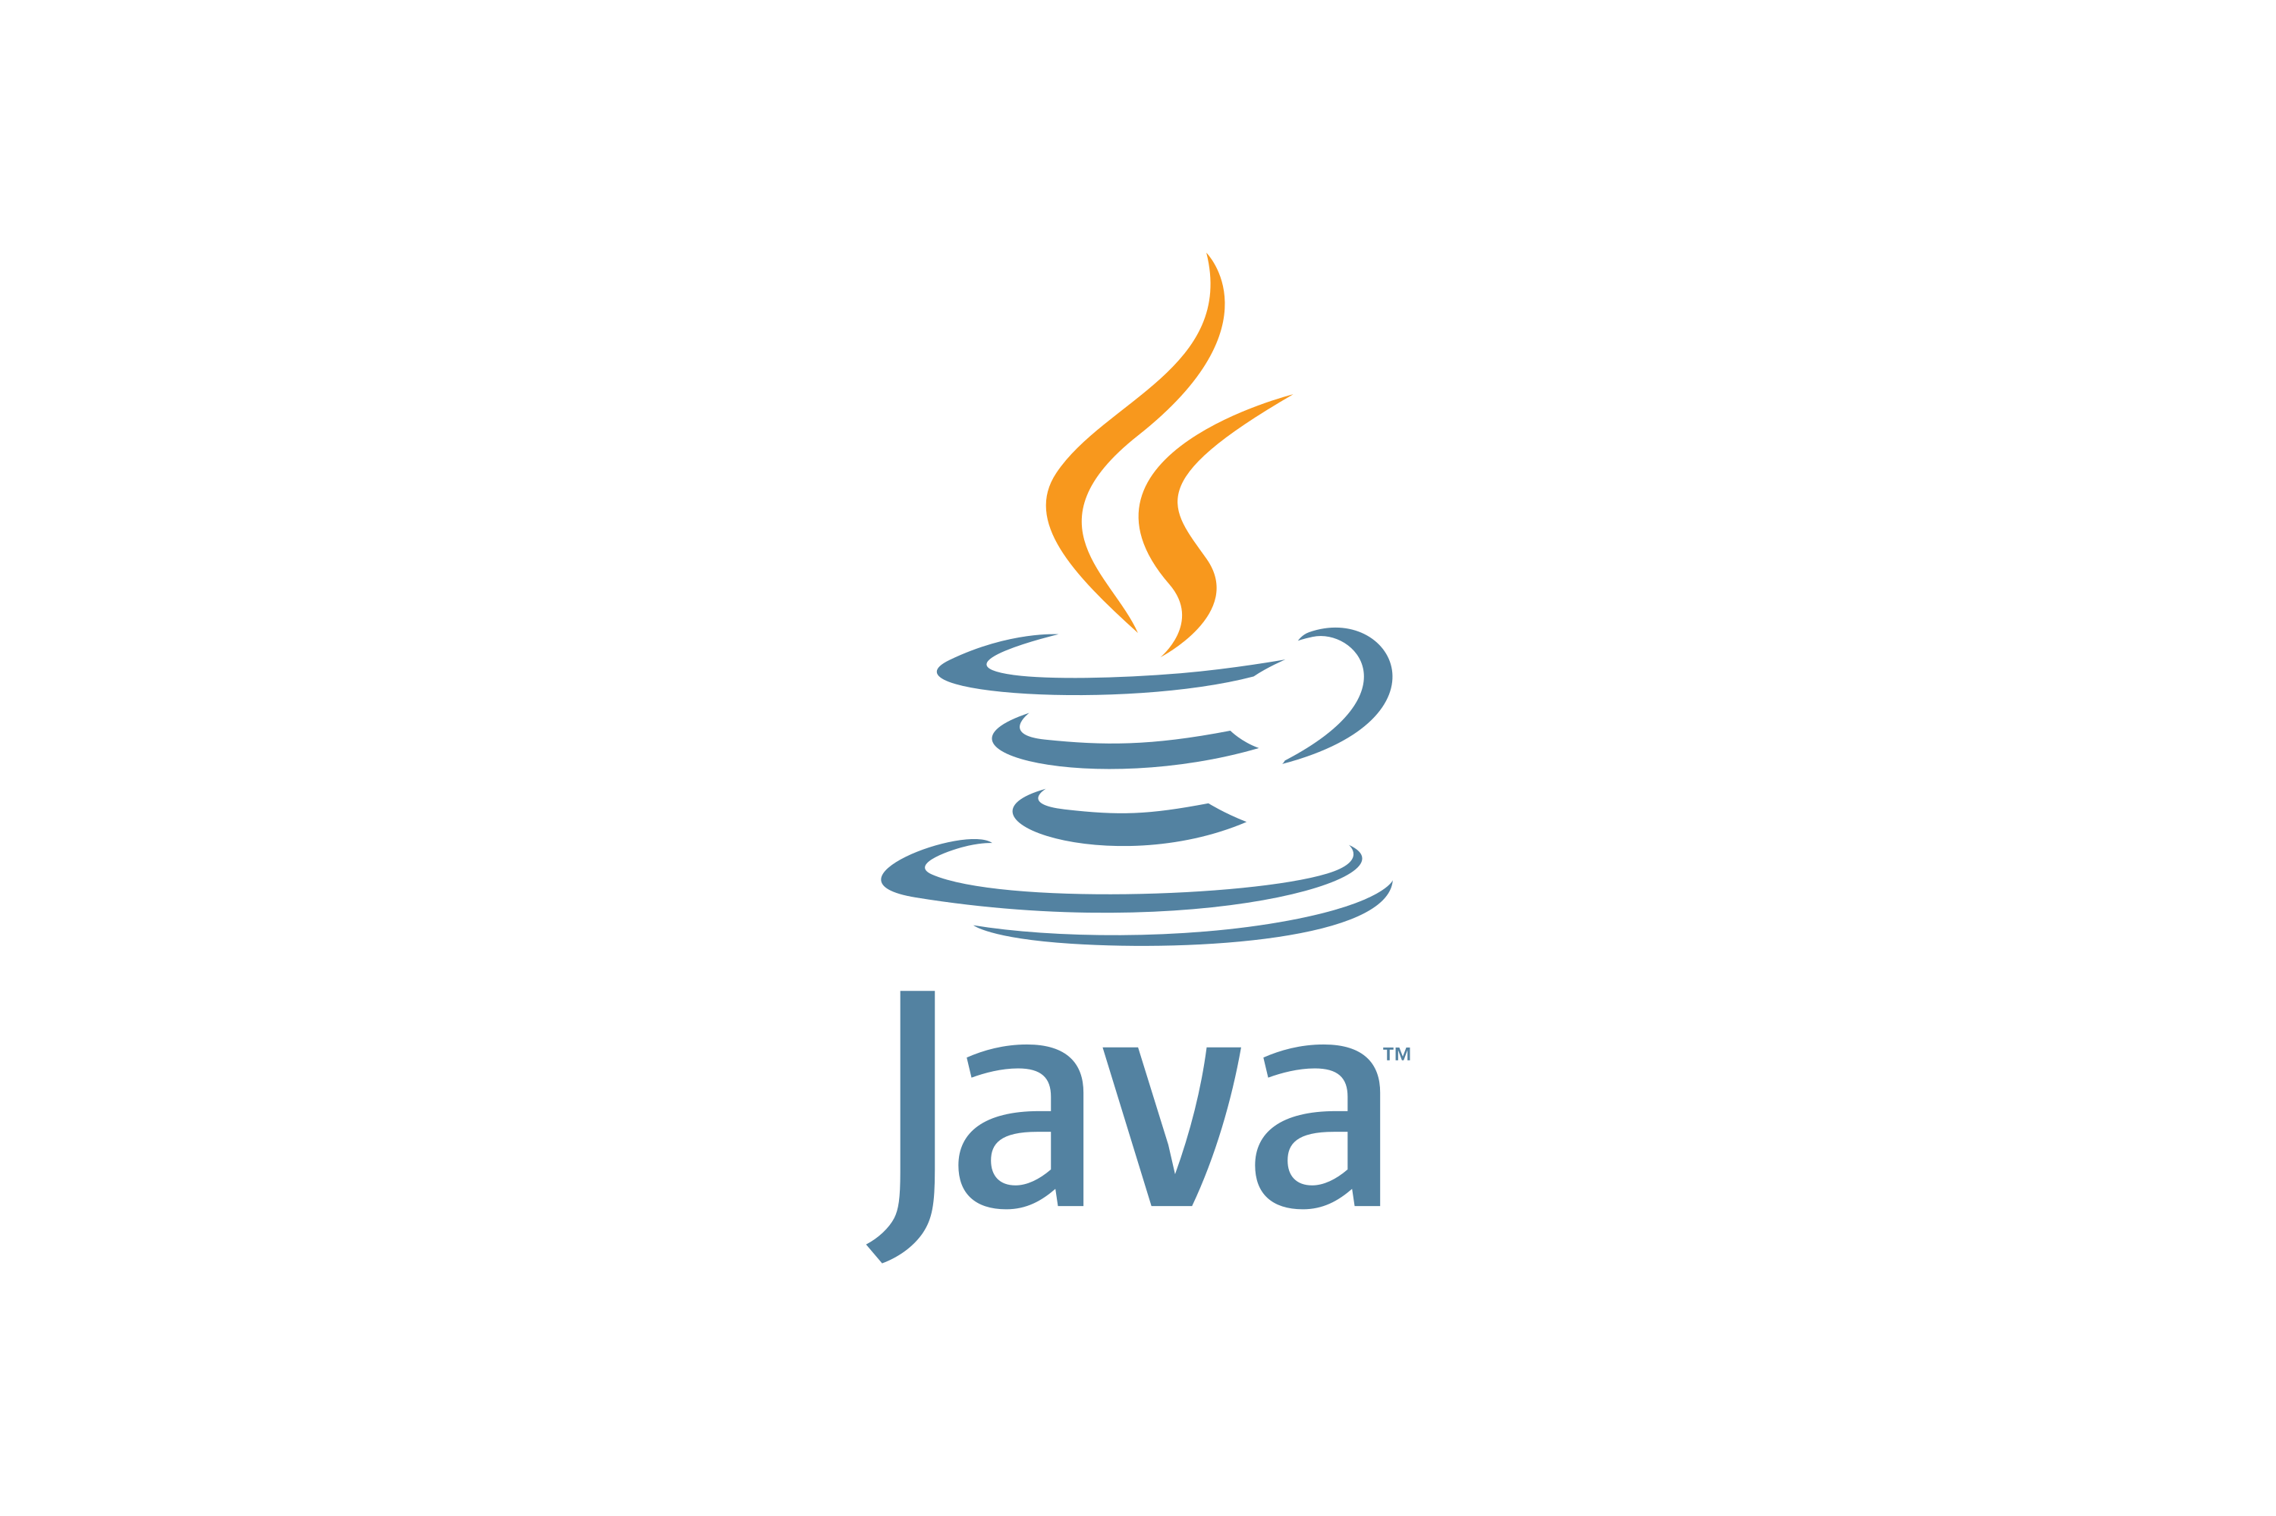
2
Java
It provides variety of frameworks and libraries such as Spring which make it easier to handle server-side logic and interact with databases like MYSQL.
Java’s strong typing make it a popular choice for backend development.

Slide 16
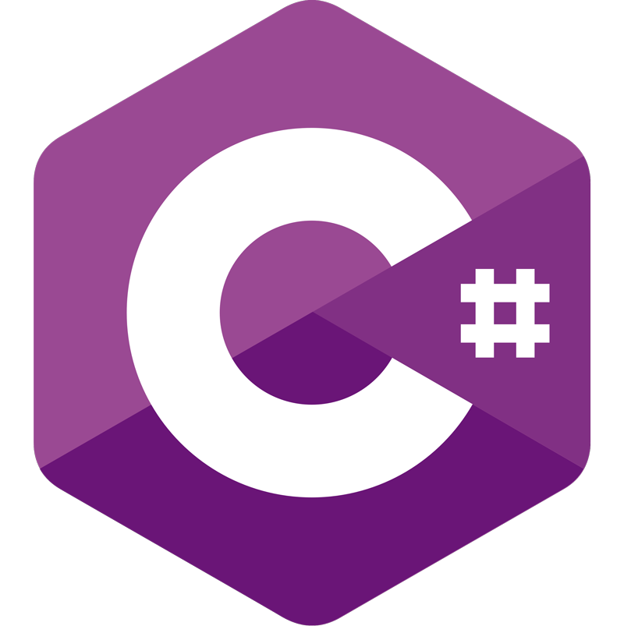
3
C# (sharp)
It’s commonly used in backend development.
It’s part of .NET framework and provides a scalable web applications.
With c# you can handle data processing, server-side logic and more.

Slide 17
Also java script works in backend as we said. It’s an essential skill for any web developer.
Note : There are more 20 languages to choose from in this career

Slide 18
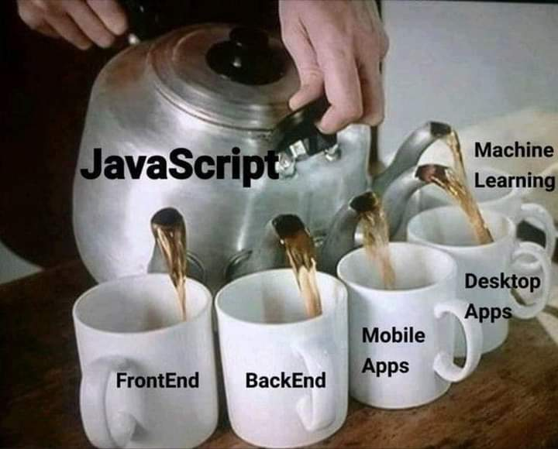

Slide 19
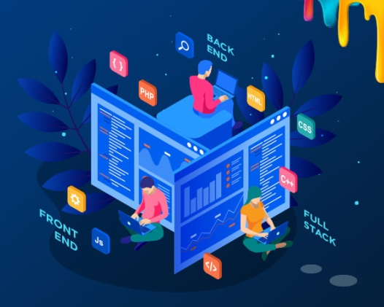
TO SUM UP
You need to have both skills: frontend and backend to be called a full stack developer.
The opportunity to work will be much easier for you !

Slide 20


THANKS
CHAOS TEAM
Slides by Loai

